Slide 1


Terrain Analysis Using Digital Elevation Models (TauDEM)
David Tarboton¹, Dan Watson², Rob Wallace,³ Kim Schreuders¹, Jeremy Neff¹
¹Utah Water Research Laboratory, Utah State University, Logan, Utah
²Computer Science, Utah State University, Logan, Utah
³US Army Engineer Research and Development Center, Information Technology Lab, Vicksburg, Mississippi
http://hydrology.usu.edu/taudem dtarb@usu.edu
This research was funded by the US Army Research and Development Center under contract number W9124Z-08-P-0420

Slide 2
Outline
Overview of principles and methods (60 min)
Break (10 min)
Hands on using ArcGIS and R (50 min)
Break (10 min)
TauDEM parallel methods (15 min)
TauDEM on CSDMS Beach (20 min)
Discussion and overrun cushion (15 min)

Slide 3
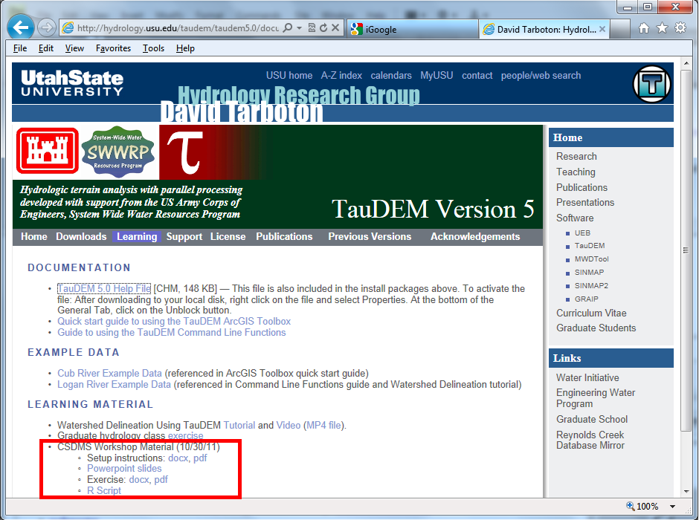
http://hydrology.usu.edu/taudem/taudem5.0/documentation.html

Slide 4
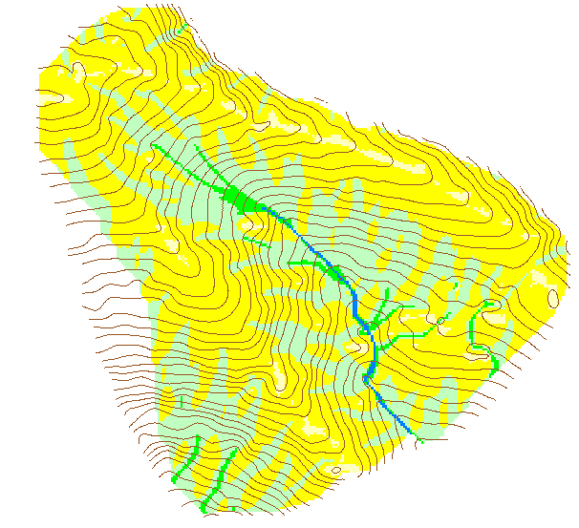
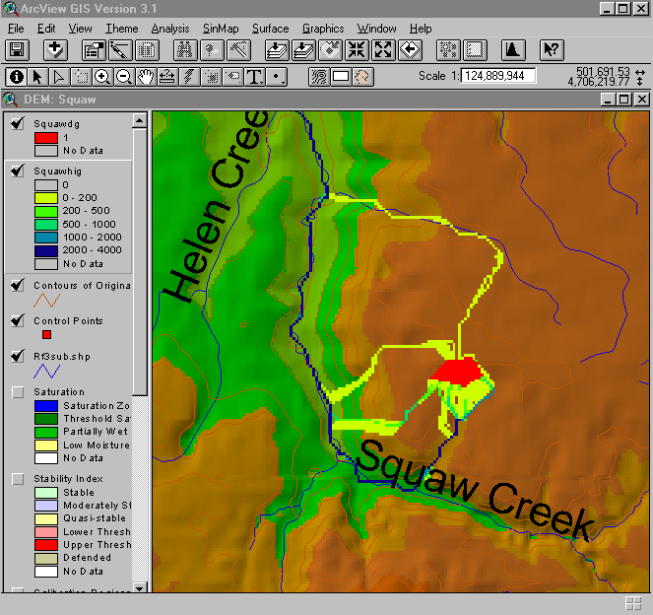
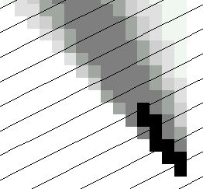
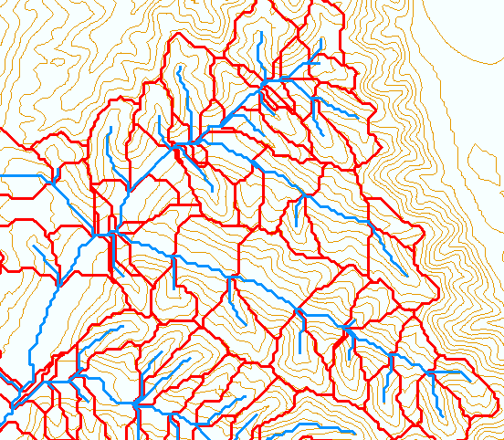
TauDEM - Channel Network and Watershed Delineation Software
Pit removal (standard flooding approach)
Flow directions and slope
D8 (standard)
D∞ (Tarboton, 1997, WRR 33(2):309)
Flat routing (Garbrecht and Martz, 1997, JOH 193:204)
Drainage area (D8 and D∞)
Network and watershed delineation
Support area threshold/channel maintenance coefficient (Standard)
Combined area-slope threshold (Montgomery and Dietrich, 1992, Science, 255:826)
Local curvature based (using Peuker and Douglas, 1975, Comput. Graphics Image Proc. 4:375)
Threshold/drainage density selection by stream drop analysis (Tarboton et al., 1991, Hyd. Proc. 5(1):81)
Other Functions: Downslope Influence, Upslope Dependence, Wetness index, distance to streams, Transport limited accumulation
Developed as C++ command line executable functions
MPICH2 used for parallelization (single program multiple data)
Relies on other software for visualization (ArcGIS Toolbox GUI)

Slide 5
Principles and methods
Fundamentals of watershed delineation
Geomorphology based channel delineation (objective support threshold determination)
D-Infinity multiple flow direction model
Generalized accumulation functionality

Slide 6
Principles and methods
Fundamentals of watershed delineation
Geomorphology based channel delineation (objective support threshold determination)
D-Infinity multiple flow direction model
Generalized accumulation functionality

Slide 7
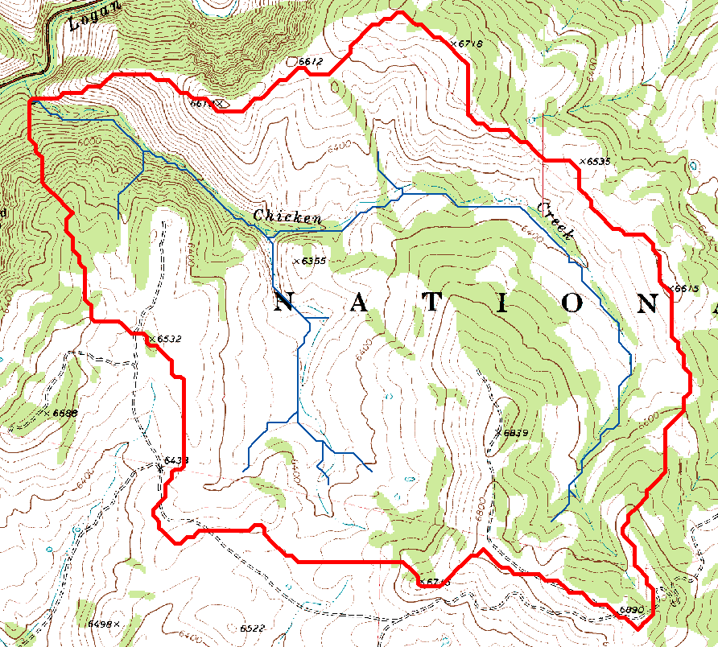
Topography defines watersheds which are fundamentally the most basic hydrologic landscape elements.

Slide 8
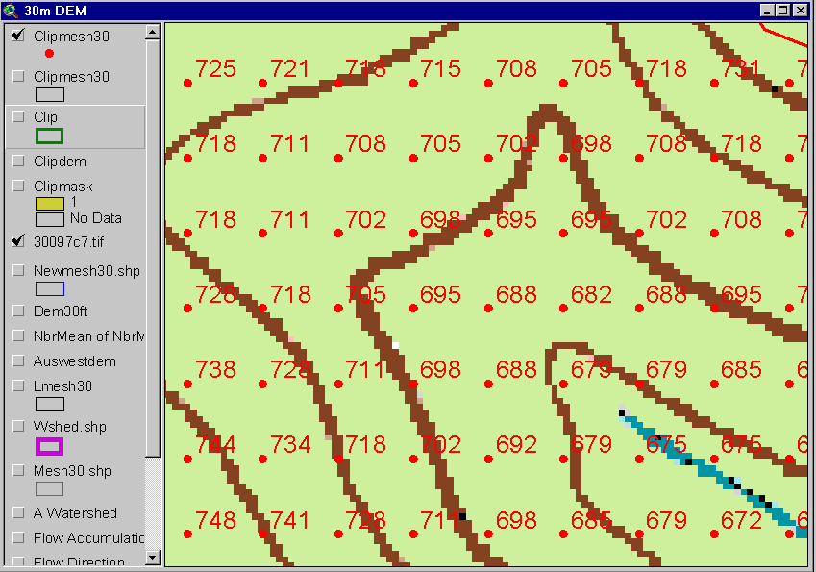
The starting point: A Grid Digital Elevation Model
720
720
Contours
740
720
700
680
740
720
700
680

Slide 9
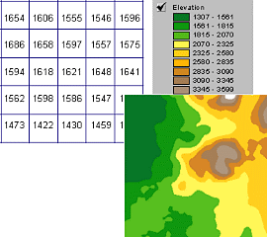
A grid defines geographic space as a mesh of identically-sized square cells. Each cell holds a numeric value that measures a geographic attribute (like elevation) for that unit of space.
Grid size is defined by extent, spacing and no data value information
Number of rows, number of column
Cell sizes (X and Y)
Top, left , bottom and right coordinates
Grid values
Real (floating decimal point)
Integer (may have associated attribute table)

Slide 10
TauDEM Grid Data Format Assumptions
Input and output grids are uncompressed GeoTIFF
Maximum size 4 GB (~32,000 x 32,000 rows and cols for single file version)
For larger areas use multifile version
GDAL Nodata tag preferred (if not present, a missing value is assumed)
Grids are square (Δx= Δy)
Grids have identical extents, cell size and spatial reference
Spatial reference information is not used (no projection on the fly)

Slide 11
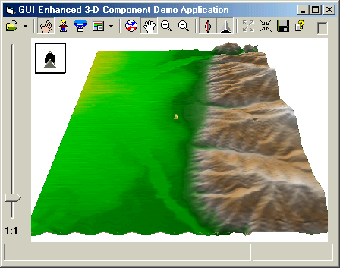

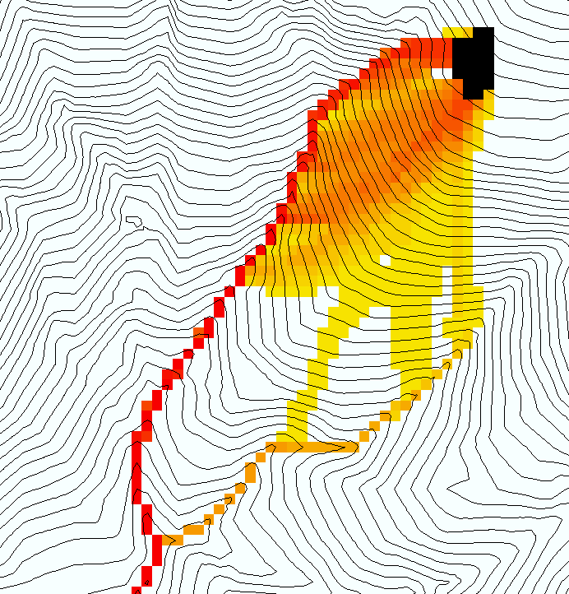
The terrain flow information model for deriving channels, watersheds, and flow related terrain information.
Raw DEM
Pit Removal (Filling)
Channels, Watersheds, Flow Related Terrain Information
Flow Field
Notes:
This slide shows the general model for deriving flow field related derivative surfaces from digital elevation data. The input is a raw digital elevation model, generally elevation values on a grid. This is basic information used to derive further hydrology related spatial fields that enrich the information content of this basic data. The first step is to remove sinks, either by filling, or carving. Then a flow field is defined. This enables the calculation of flow related terrain information. My focus has been on flow related information working within this framework. I try to leave other GIS functionality, like radiation exposure, line of sight analyses and visualization to others. I have distributed my software in ways that it easily plugs in to mainstream systems, such as ArcGIS to enhance ease of use.

Slide 12
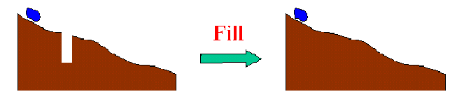
The Pit Removal Problem
DEM creation results in artificial pits in the landscape
A pit is a set of one or more cells which has no downstream cells around it
Unless these pits are removed they become sinks and isolate portions of the watershed
Pit removal is first thing done with a DEM

Slide 13
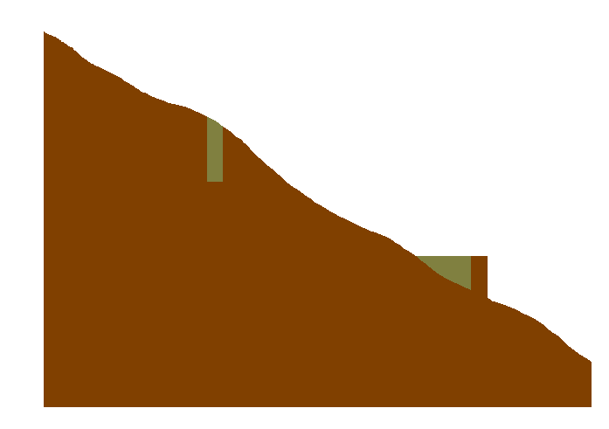

Pit Filling
Increase elevation to the pour point elevation until the pit drains to a neighbor

Slide 14
Pit Filling
Original DEM
Pits Filled
Pits
Pour Points
Notes:
Elevations are filled to that of the pools pour point

Slide 15
D8 Flow Direction Model
- Direction of steepest descent
30
80
74
63
4
3
2
69
67
56
5
1
60
52
48
6
7
8
Slope = Drop/Distance
Steepest down slope direction

Slide 16
Grid Network

Slide 17
Contributing Area (Flow Accumulation)
1
1
1
1
1
1
1
1
1
1
1
3
3
3
1
1
3
3
3
1
1
1
11
1
2
1
1
1
2
11
2
1
1
15
1
2
1
1
1
15
1
5
2
20
2
1
5
2
2
20
The area draining each grid cell includes the grid cell itself.

Slide 18
Stream Definition
Flow Accumulation > 10 Cell Threshold
Stream Network for 10 cell Threshold Drainage Area
1
1
1
1
1
1
1
1
1
1
1
3
3
3
1
1
3
3
3
1
1
1
11
1
2
1
1
2
1
11
2
1
1
15
1
2
1
1
1
15
1
5
2
20
2
1
5
2
2
20

Slide 19
Watershed Draining to Outlet

Slide 20
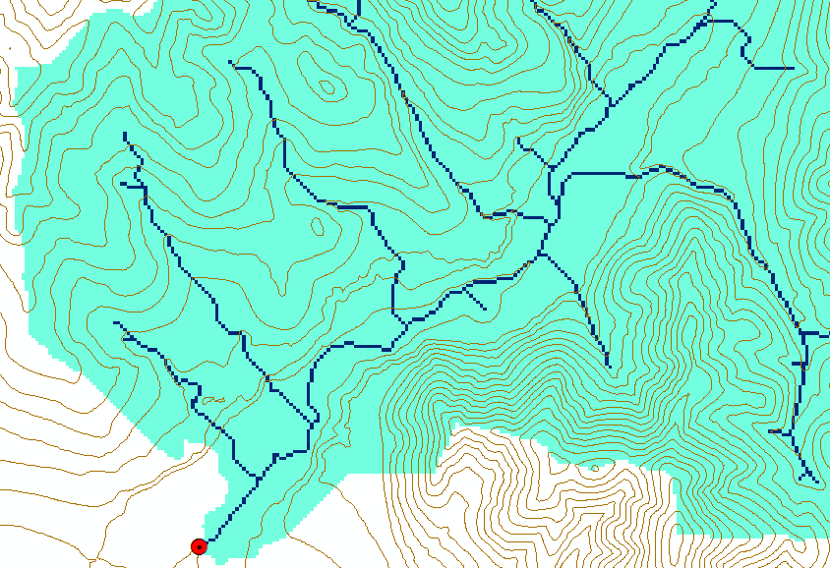
Watershed and Stream Grids

Slide 21
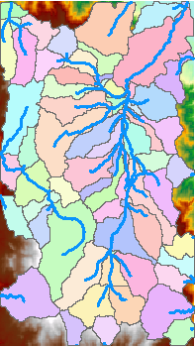
DEM Delineated Catchments and Stream Networks
For every stream segment, there is a corresponding catchment
Catchments are a tessellation of the landscape
Based on the D8 flow direction model

Slide 22
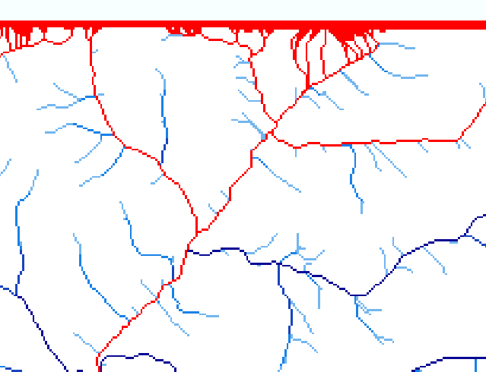
Edge contamination
Edge contamination arises due to the possibility that a contributing area value may be underestimated due to grid cells outside of the domain not being counted. This occurs when drainage is inwards from the boundaries or areas with no data values. The algorithm recognizes this and reports "no data" resulting in streaks of "no data" values extending inwards from boundaries along flow paths that enter the domain at a boundary.

Slide 23
Principles and methods
Fundamentals of watershed delineation
Geomorphology based channel delineation (objective support threshold determination)
D-Infinity multiple flow direction model
Generalized accumulation functionality

Slide 24
How to decide on stream delineation threshold ?
AREA 2
3
AREA 1
12
Why is it important?

Slide 25
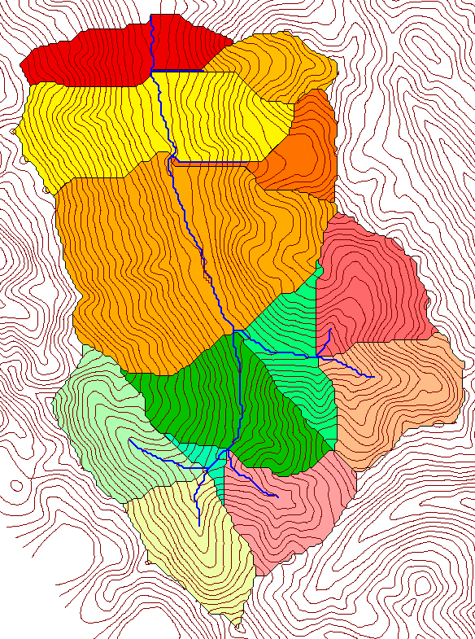
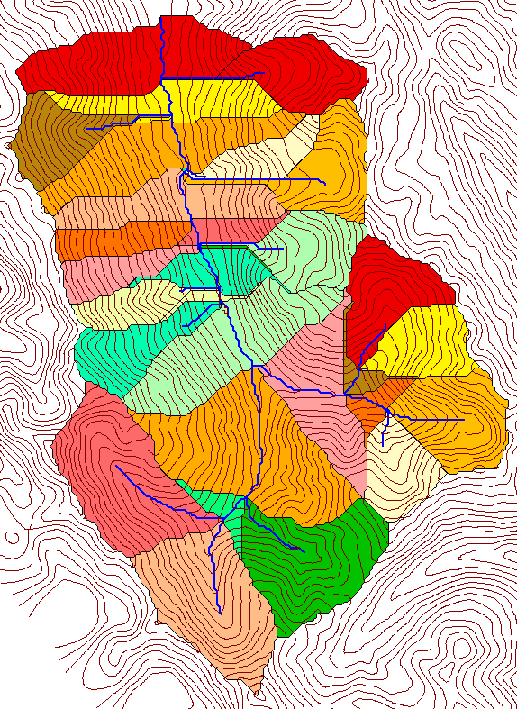
Delineation of Channel Networks and Catchments
500 cell theshold
1000 cell theshold

Slide 26
Hydrologic processes are different on hillslopes and in channels. It is important to recognize this and account for this in models.
Drainage area can be concentrated or dispersed (specific catchment area) representing concentrated or dispersed flow.

Slide 27
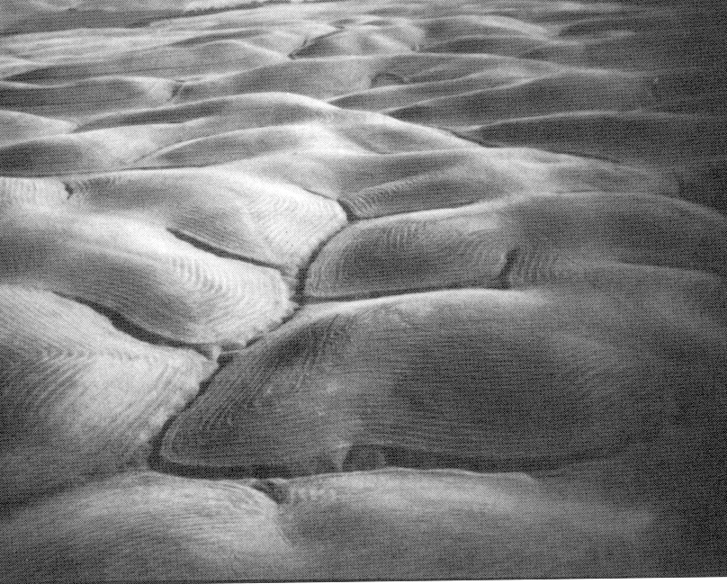
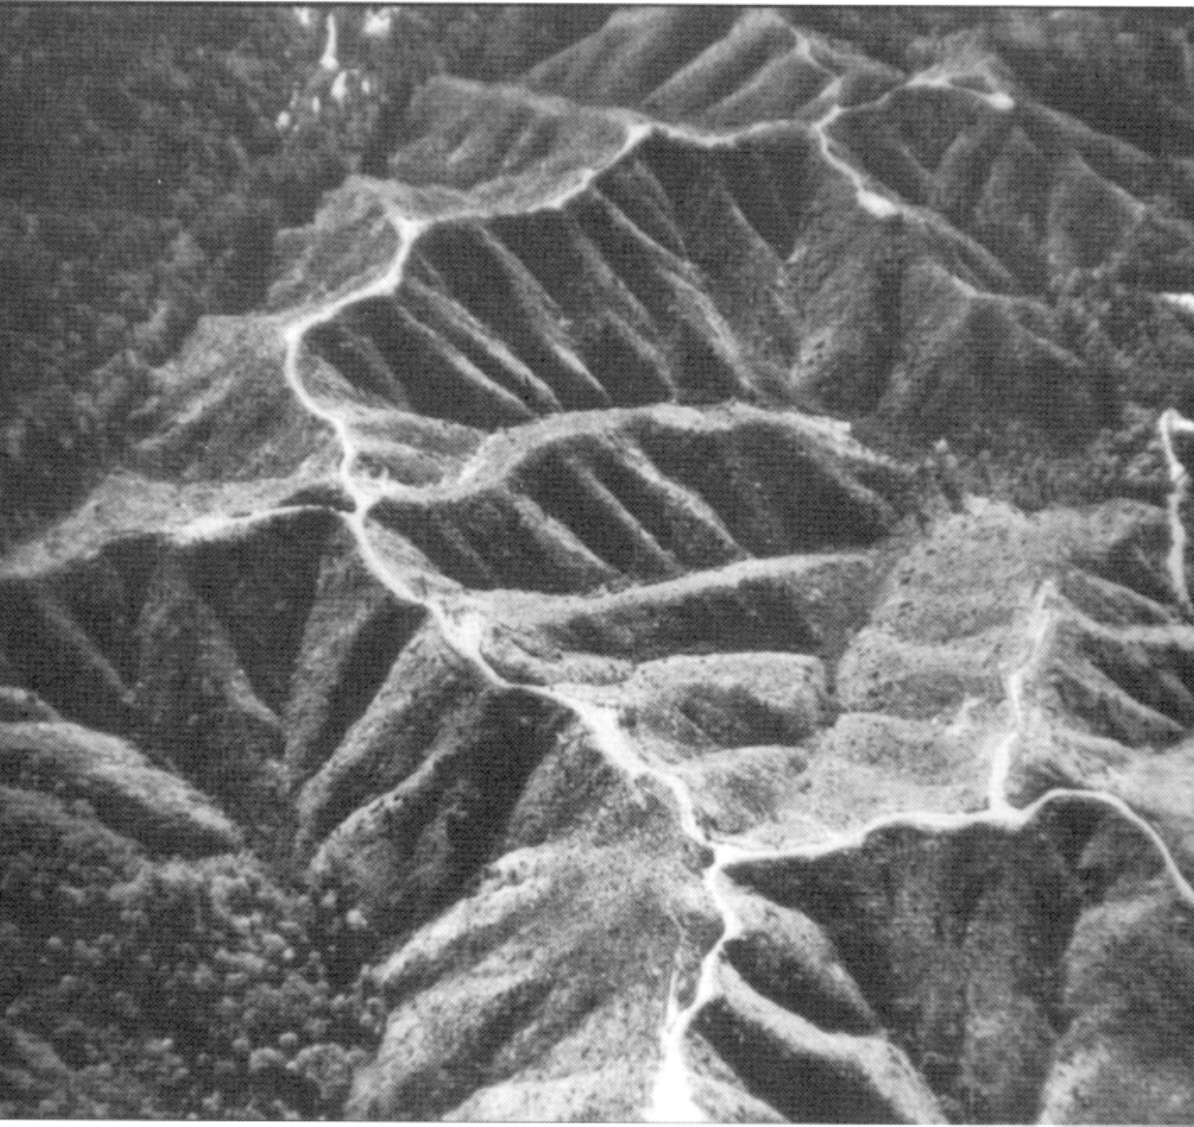
Examples of differently textured topography
From W. E. Dietrich
From W. E. Dietrich

Slide 28
“landscape dissection into distinct valleys is limited by a threshold of channelization that sets a finite scale to the landscape.” (Montgomery and Dietrich, 1992, Science, vol. 255 p. 826.)
Suggestion: One contributing area threshold does not fit all watersheds.
Lets look at some geomorphology.
Drainage Density
Horton’s Laws
Slope – Area scaling
Stream Drops

Slide 29
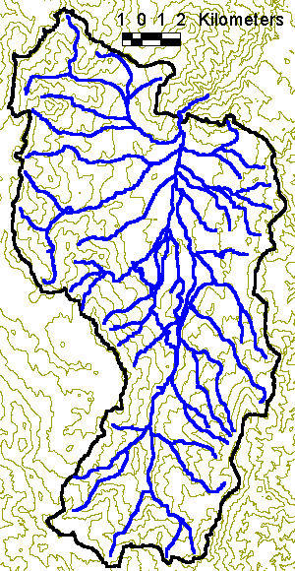
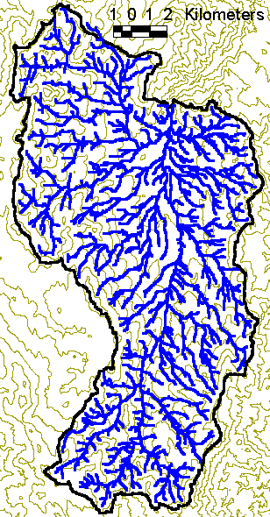
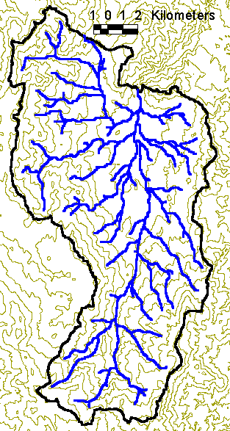
Drainage Density for Different Contributing Area Thresholds
EPA Reach Files
100 grid cell threshold
1000 grid cell threshold
D_{d} = L/A
Hillslope length ≈ 1/2D_{d}

Slide 30
Drainage Density Versus Contributing Area Threshold

Slide 31
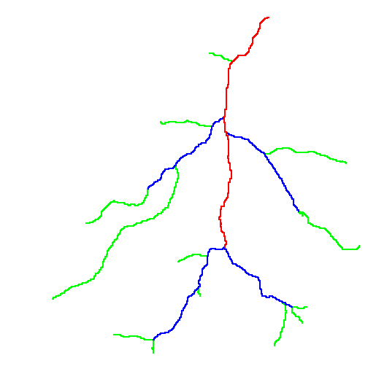
Hortons Laws: Strahler system for stream ordering
1
3
1
2
1
2
1
1
1
1
1
2
2
1
1
1
1
1
1

Slide 32
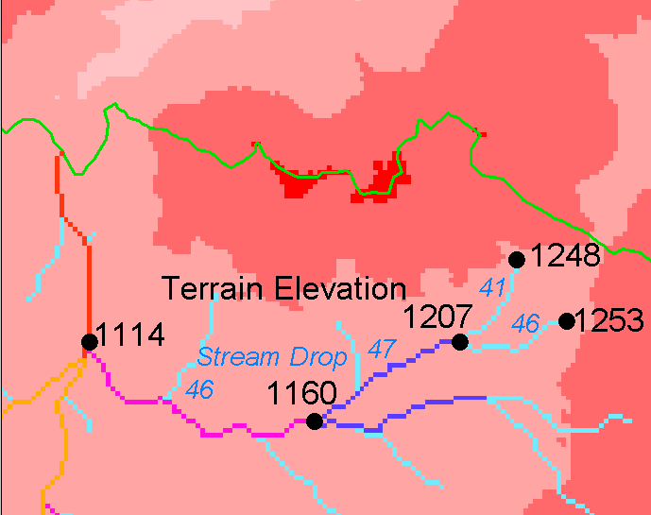
Constant Stream Drops Law
Average elevation difference between ends of Strahler streams
Broscoe, A. J., (1959), "Quantitative analysis of longitudinal stream profiles of small watersheds," Office of Naval Research, Project NR 389-042, Technical Report No. 18, Department of Geology, Columbia University, New York.

Slide 33
Suggestion: Map channel networks from the DEM at the finest resolution consistent with observed channel network geomorphology ‘laws’.
Look for statistically significant break in constant stream drop property as stream delineation threshold is reduced
Break in slope versus contributing area relationship
Physical basis in the form instability theory of Smith and Bretherton (1972), see Tarboton et al. 1992

Slide 34
Statistical Analysis of Stream Drops

Slide 35
T-Test for Difference in Mean Values
0
72
130
T-test checks whether difference in means is large (> 2)
when compared to the spread of the data around the mean values

Slide 36
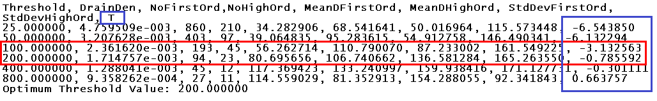
Optimal Contributing Area Threshold

Slide 37
100 grid cell contributing area threshold stream delineation

Slide 38
200 grid cell contributing area threshold stream delineation

Slide 39
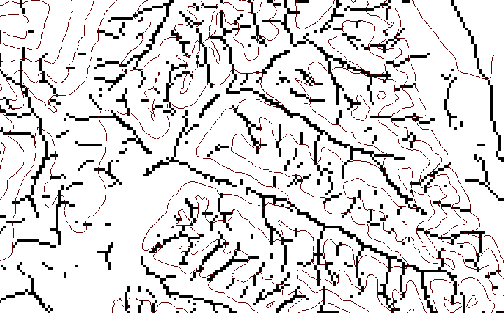
Peuker Douglas “Valley” Computation (Peuker and Douglas, 1975, Comput. Graphics Image Proc. 4:375)
43
48
48
51
51
56
41
47
47
54
54
58

Slide 40
Flow accumulation of “valley” grid cells only

Slide 41
“Valley” Flow accumulation Threshold

Slide 42
Peuker Douglas “Valley” based stream delineation

Slide 43
Channel network delineation, other options
4
3
2
5
1
6
7
8
Contributing Area
Grid Order
1
1
1
1
1
1
1
1
1
1
1
4
3
3
1
1
2
2
2
1
1
1
12
1
2
1
1
3
1
1
1
1
2
16
1
1
1
1
3
1
1
3
6
25
2
1
2
2
3
1

Slide 44
Grid network pruned to order 4 stream delineation

Slide 45
Principles and methods
Fundamentals of watershed delineation
Geomorphology based channel delineation (objective support threshold determination)
D-Infinity multiple flow direction model
Generalized accumulation functionality

Slide 46
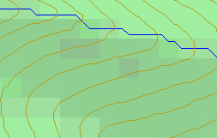
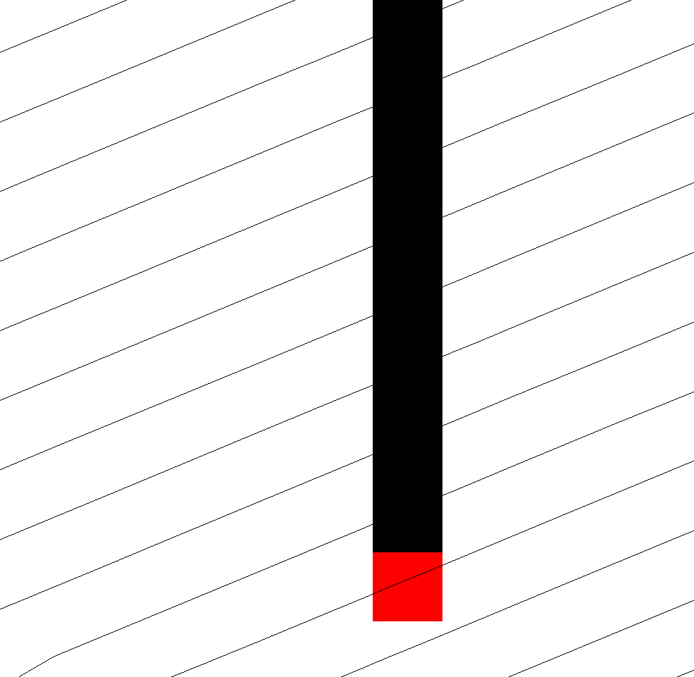
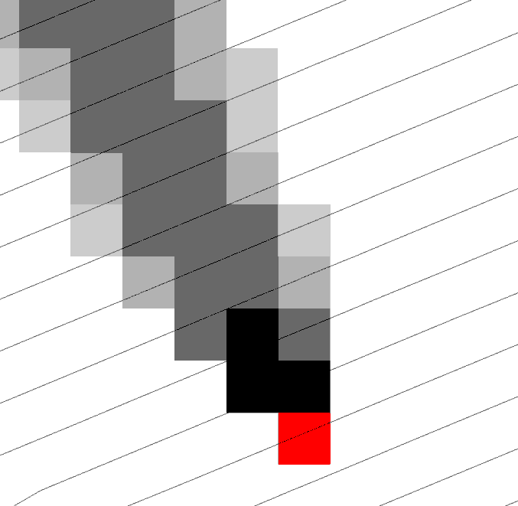
Representation of Flow Field
Steepest single direction
48
52
56
67
D8
D∞
Tarboton, D. G., (1997), "A New Method for the Determination of Flow Directions and Contributing Areas in Grid Digital Elevation Models," Water Resources Research, 33(2): 309-319.)
Notes:
This slide shows how the terrain flow field is represented. Early DEM work used a single flow direction model, D8. In 1997 I published the Dinfinity method that proportions flow from each grid cell among downslope neighbors. This, at the expense of some dispersion, allows a better approximation of flow across surfaces.

Slide 47
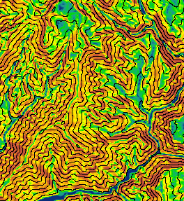
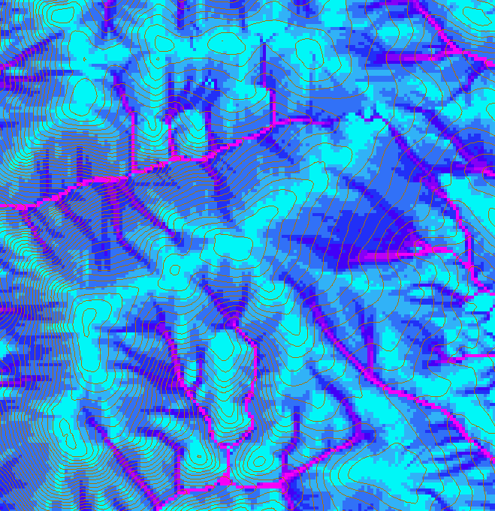
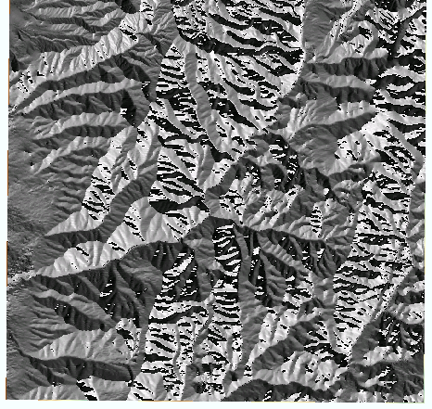
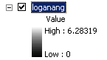
D-Infinity Slope, Flow Direction and Contributing Area

Slide 48
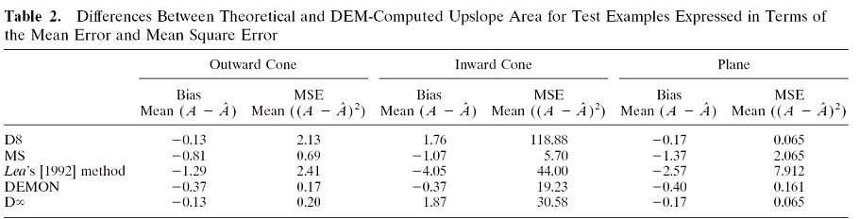
Contributing Area
D∞
D8
<1 ha
1-4 ha
4-8 ha
>8 ha

Slide 49
Principles and methods
Fundamentals of watershed delineation
Geomorphology based channel delineation (objective support threshold determination)
D-Infinity multiple flow direction model
Generalized accumulation functionality

Slide 50
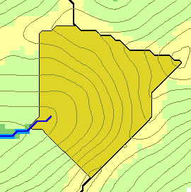
Contributing area – General accumulation function
w(x)
x

Slide 51
Pseudocode for Recursive Flow Accumulation
Global P, w, A, Δ FlowAccumulation(i) for all k neighbors of i if P_{ki}>0 FlowAccumulation(k) next k return
P_{ki}

Slide 52
General Pseudocode Upstream Flow Algebra Evaluation
Global P, γ, θ FlowAlgebra(i) for all k neighbors of i if P_{ki}>0 FlowAlgebra(k) next k θ_{i} = FA(γ_{i}, P_{ki}, θ_{k}, γ_{k}) return
P_{ki}

Slide 53
Example: Retention limited runoff generation with run-on
Global P, (r,c), q FlowAlgebra(i) for all k neighbors of i if P_{ki}>0 FlowAlgebra(k) next k return
q_{k}
r
q_{i}
c

Slide 54
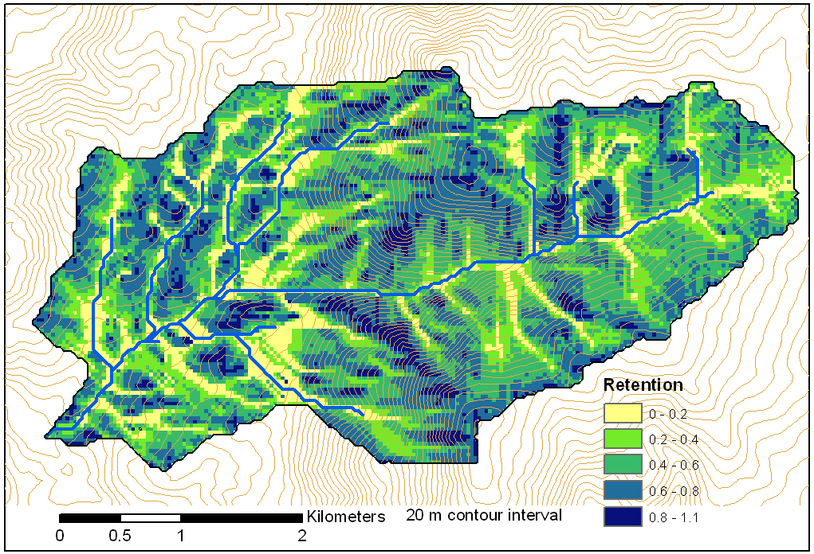
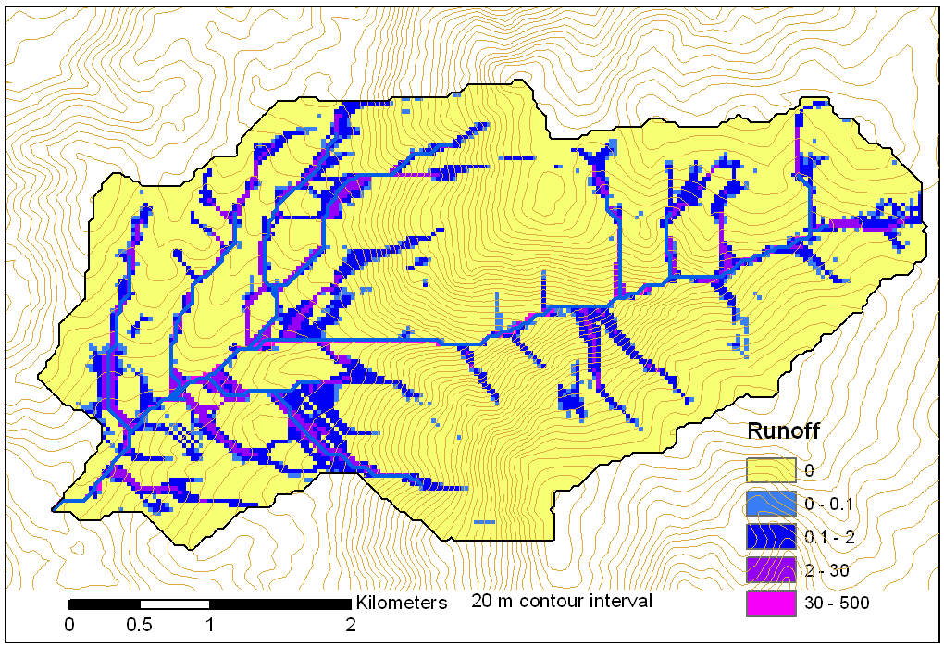
Retention limited runoff with run-on
Retention Capacity
A
C
r=5
c=6
q_{in}=1.8
q=0.8
r=7
c=4
q=3
0.6
1
Runoff from uniform input of 0.25
r=4
c=6
q=0
0.4
r=4
c=5
q_{in}=2
q=1
1
B
D
Notes:
Figure 2 illustrates the evaluation of infiltration capacity limited runoff generation with run on according to (5). Inputs are the r and c values indicated, with the proportional flow directions indicated by the arrows. Grid cells A and B on the left have no dependencies so may be immediately evaluated and using min(r-c,0) result in q=3 and 0 for grid cells A and B respectively. With these evaluated, the unevaluated dependencies of grid cell C become 0, so equation (5) can be evaluated for grid cell C. The inflow is q_{in}=0.6 x 3 = 1.8 from grid cell B. Then q=min(5-6+1.8,0)=0.8. Now all dependencies of D have been evaluated. Inflows from cells A, B, and C, accounting for the proportions are 3 x 0.4 + 0.8 = 2, so the runoff from D is q=min(4-5+2,0)=2.

Slide 55
Useful for a tracking contaminant or compound subject to decay or attenuation

Slide 56
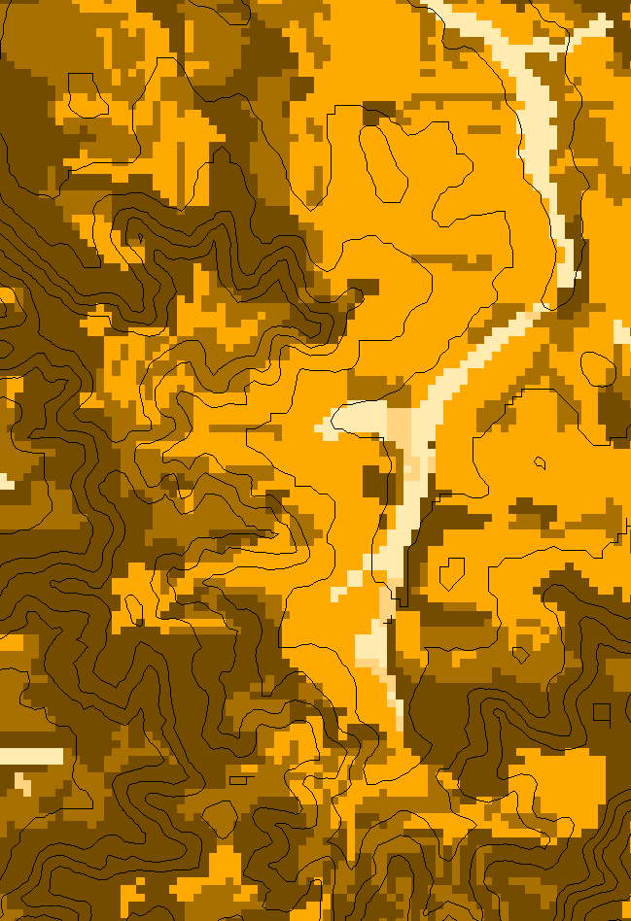
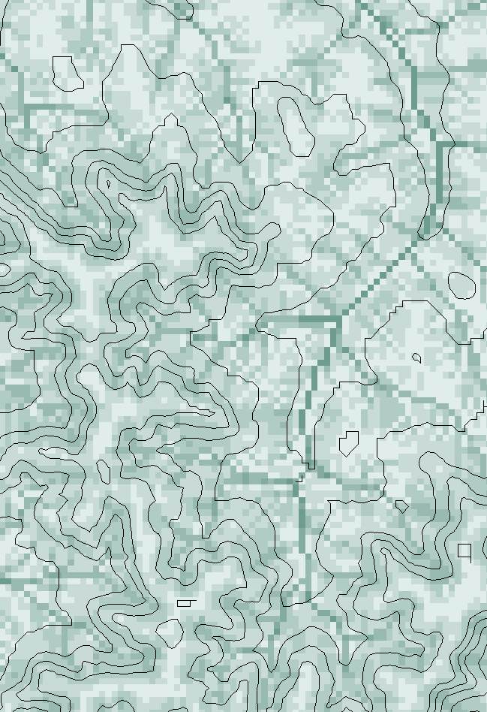
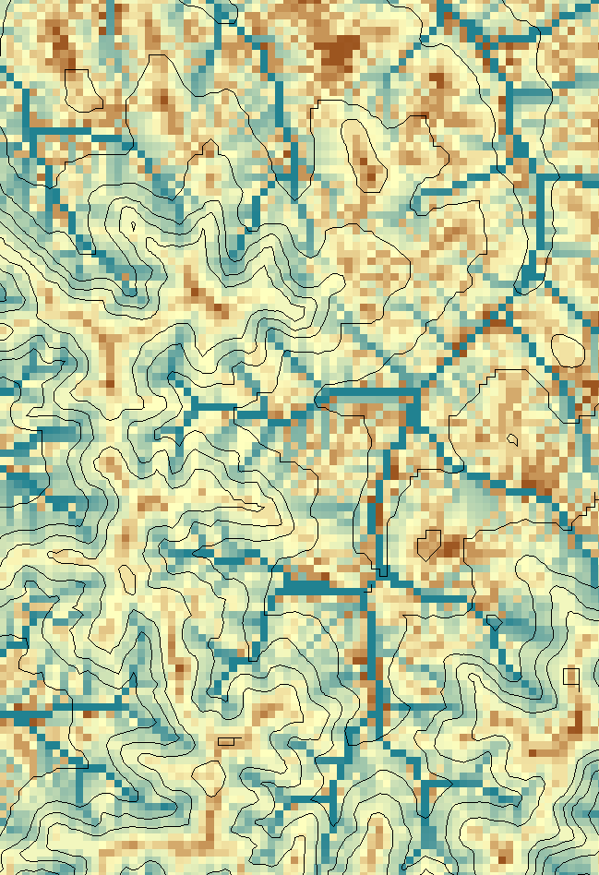
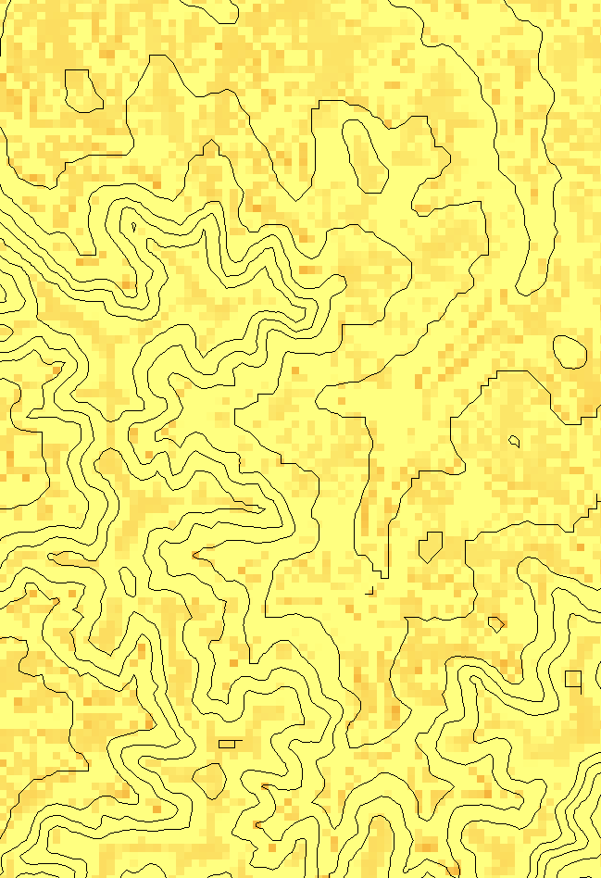
Transport limited accumulation
Supply
Capacity
Transport
Deposition
S
T
=
χa
2
tan(
b
)
2
T
=
min{
S
+
∑
T
,
T
}
D
=
S
+
∑
T
−
T
cap
out
in
cap
in
out
Useful for modeling erosion and sediment delivery, the spatial dependence of sediment delivery ratio and contaminant that adheres to sediment

Slide 57
General Pseudocode Downstream Flow Algebra Evaluation
Global P, γ, θ FlowAlgebra(i) for all k neighbors of i if P_{ik}>0 FlowAlgebra(k) next k θ_{i} = FA(γ_{i}, P_{ik}, θ_{k}, γ_{k}) return
P_{ki}

Slide 58
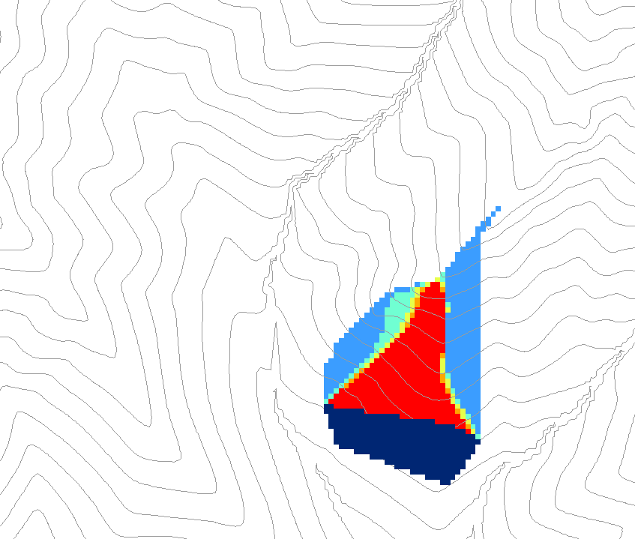
0.6
0
0
0.3
0.3
0
0
0.6
0
0
1
0
0
1
0
Grid cells y
Dependence function of grid cells y
Useful for example to track where a contaminant may come from

Slide 59
Weighted distance to target set
0
0
0
0
0
30*0.5/2
7.5
30
7.5+42.4*
(0.7+0.5)/2
32.9
38.2
38.2
38.2
38.2
38.2
To quantify effectiveness of riparian zone sediment capture based on buffer potential

Slide 60
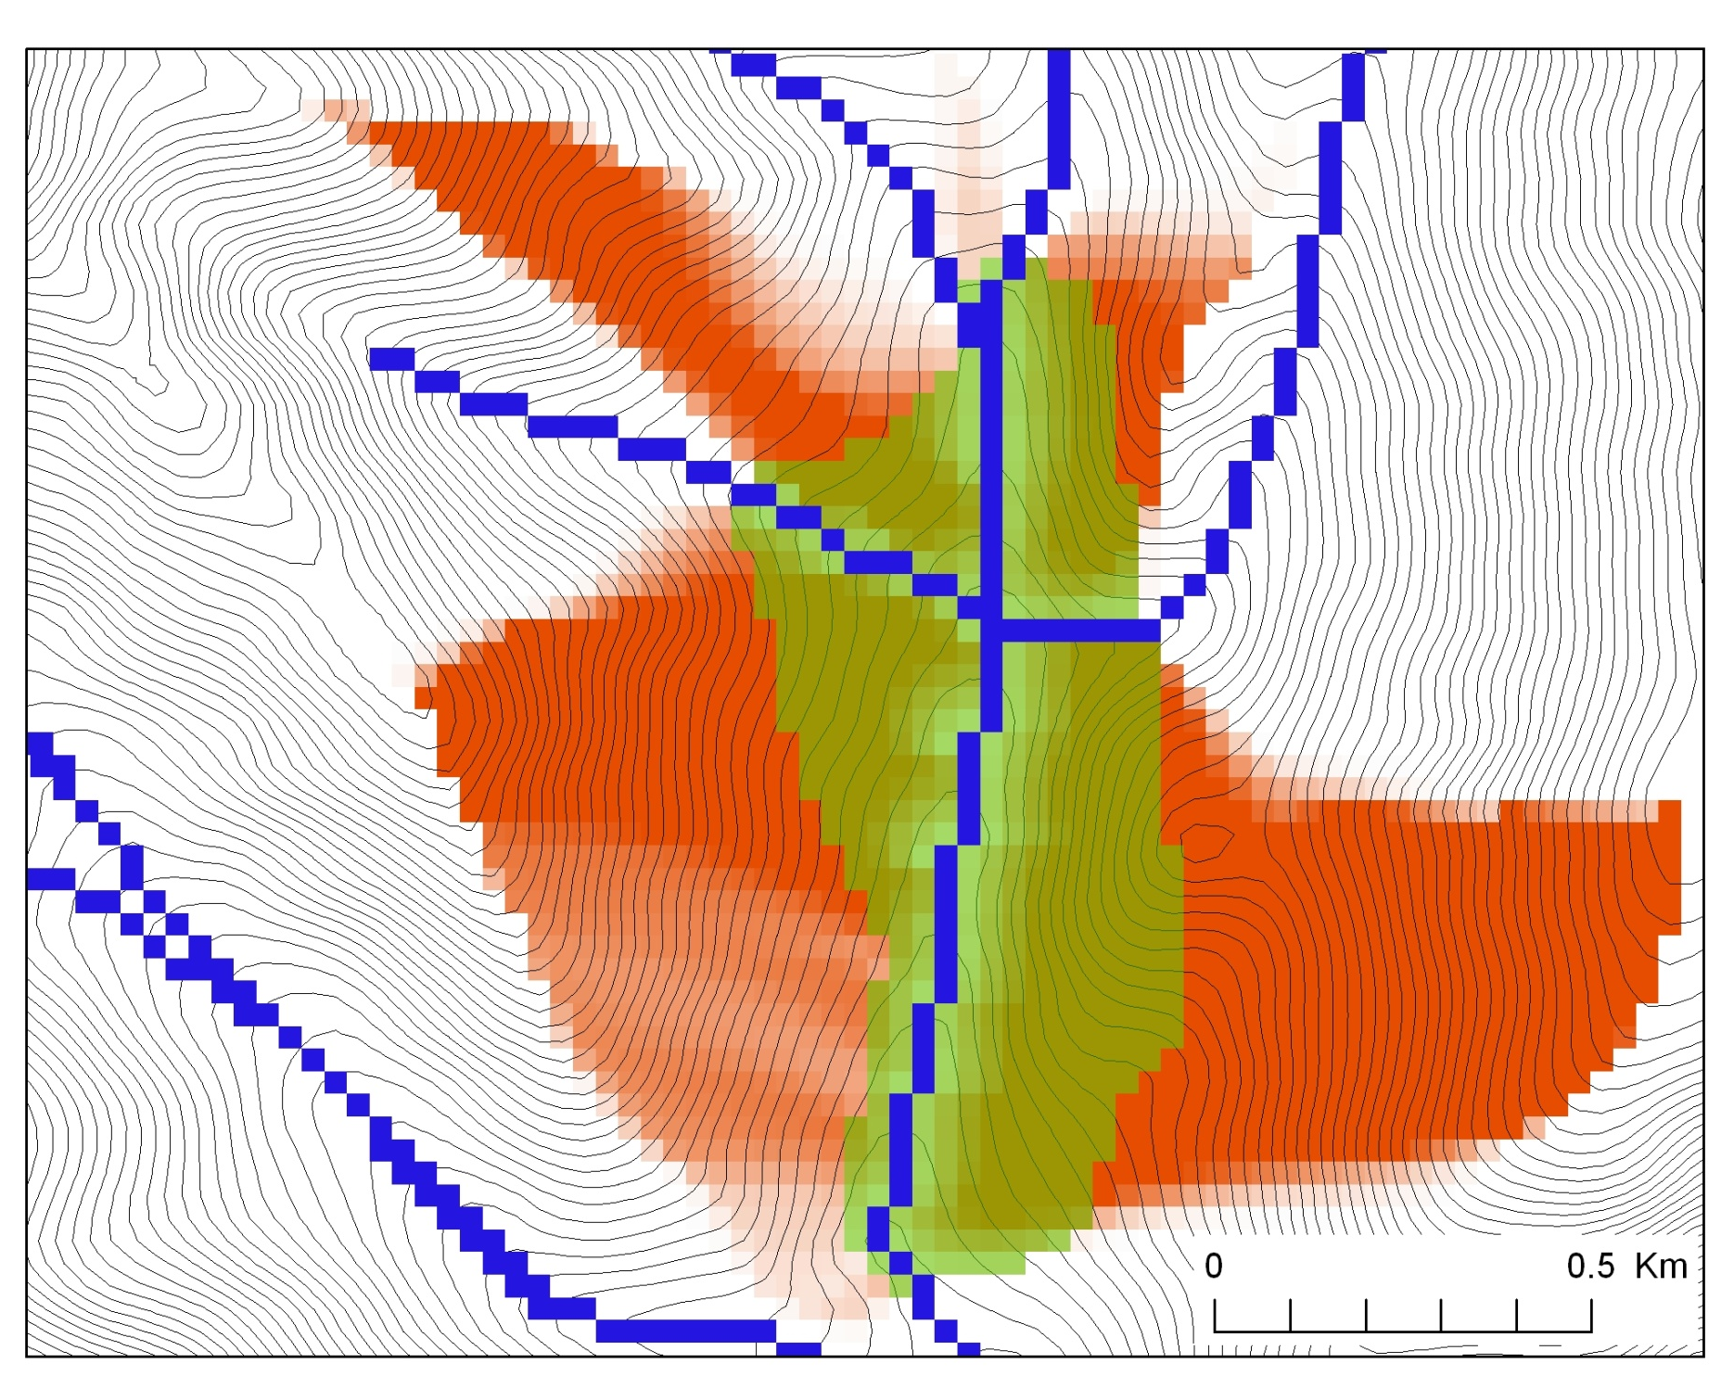
Buffer potential weighted distance to stream

Slide 61
Distance Down and Distance Up
Ridge
Ridge
sr
sr
pr
pr
vr
Point of interest
vr
Point of interest
Stream
Stream
ps
ps
vs
ss
vs
ss
hr
hs
hr
hs
Types of distance measurements possible in distance down and distance up functions.

Slide 62
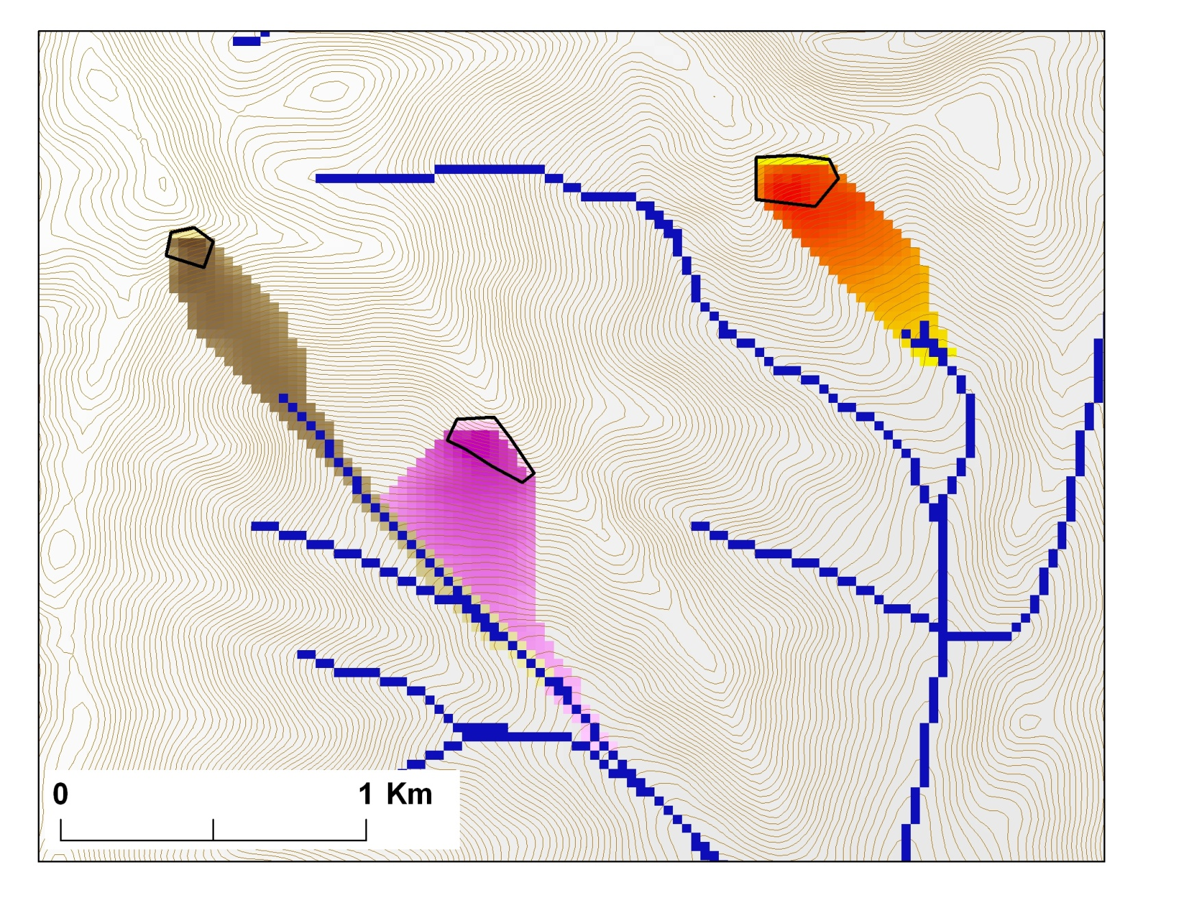
Avalanche Runout
α
Upslope recursion to determine elevation and distance to point in trigger zone that has the highest alpha angle

Slide 63
Summary Concepts
The GIS grid based terrain flow data model enables the representation of flow processes at and near the earth surface and derivation of a wide variety of information useful for the study of hydrologic processes.
Slope
Flow direction
Drainage area
Catchments, watersheds and channel networks
Multiple other flow related quantities

Slide 64
Summary Concepts (2)
Hydrologic processes are different between hillslopes and channels
Drainage density defines the average spacing between streams and the representative length of hillslopes
The constant drop property provides a basis for selecting channel delineation criteria to preserve the natural drainage density of the topography
Generalized channel delineation criteria can represent spatial variability in the topographic texture and drainage density

Slide 65
Summary Concepts (3)
Flow algebra generalizes the recursive flow accumulation methodology
Downslope and upslope logic
Several new flow algebra functions
Edge contamination checking is important to ensure that results are not impacted by area outside the domain of the DEM analyzed

Slide 66
Outline
Overview of principles and methods (60 min)
Break (10 min)
Hands on using ArcGIS and R (50 min)
Break (10 min)
TauDEM parallel methods (15 min)
TauDEM on CSDMS Beach (20 min)
Discussion and overrun cushion (15 min)

Slide 67
Outline
Overview of principles and methods (60 min)
Break (10 min)
Hands on using ArcGIS and R (50 min)
Break (10 min)
TauDEM parallel methods (15 min)
TauDEM on CSDMS Beach (20 min)
Discussion and overrun cushion (15 min)

Slide 68
Digital Elevation Model data
Obtained from http://seamless.usgs.gov
Should be projected (need to use a GIS for this)
TauDEM needs GeoTIFF
If larger than 4 GB use multiple files that cover the domain and MF version (on Beach)
GDAL useful to translate to TIFF format
http://www.gdal.org/
http://trac.osgeo.org/gdal/wiki/DownloadingGdalBinaries

Slide 69
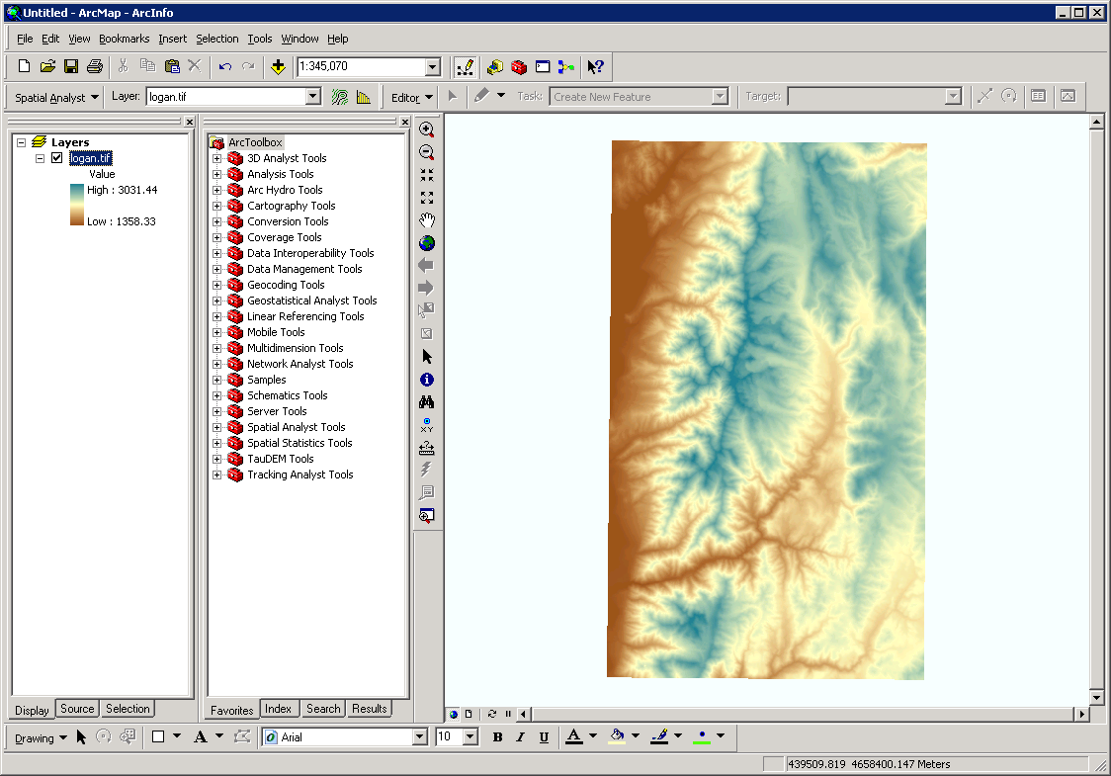
ArcMap

Slide 70
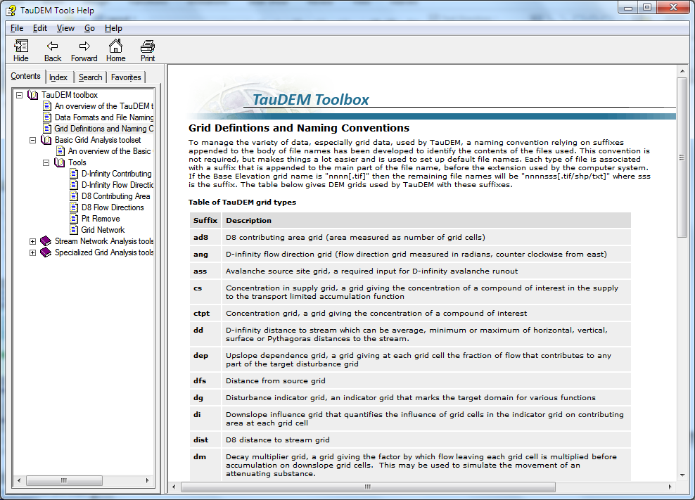
Default file name suffixes
For complete list see: http://hydrology.usu.edu/taudem/taudem5.0/TauDEM_Tools.chm

Slide 71
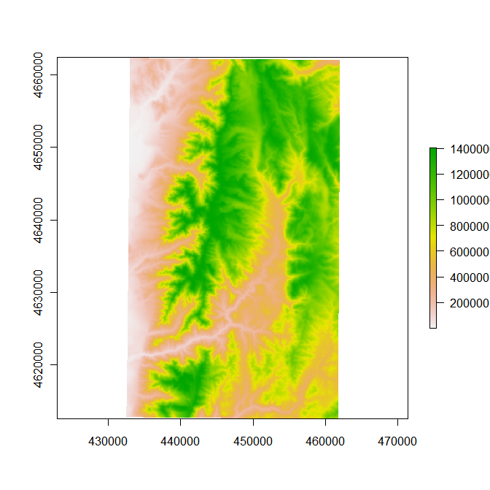
R
z=raster("logan.tif")
plot(z)

Slide 72
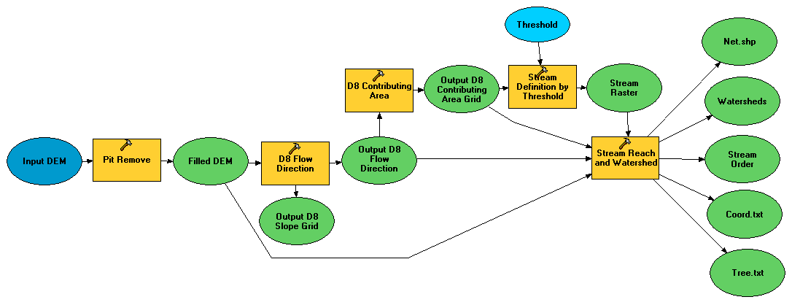
Illustrative Use Case: Delineation of channels and watersheds using a constant support area threshold
Steps
Pit Remove
D8 Flow Directions
D8 Contributing Area
Stream Definition by Threshold
Stream Reach and Watershed

Slide 73
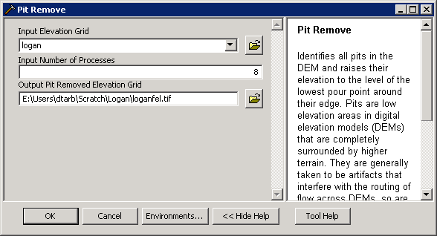
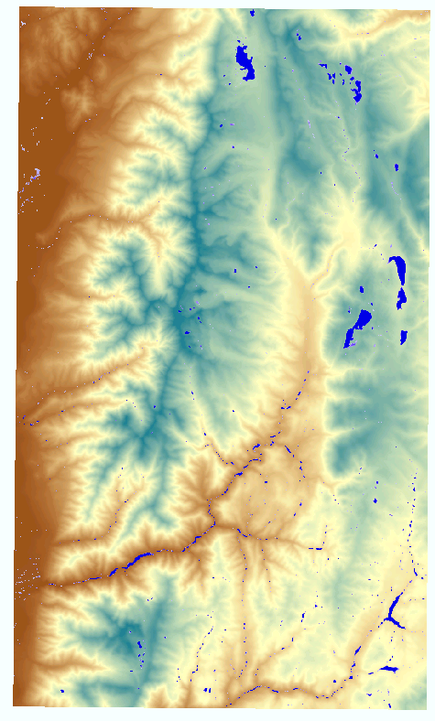

Pit Remove

Slide 74







D8 Flow Direction (and Slope)

Slide 75


D8 Contributing Area

Slide 76


Stream Definition by Threshold

Slide 77


Stream Reach and Watershed

Slide 78

Topographic wetness index from the Dinfinity method
Steps
Pit Remove
D-Infinity Flow Directions (and Slopes)
D-Infinity Contributing Area
Slope Over Area Ratio

Slide 79

D-Infinity Contributing Area

Slide 80




Wetness Index
Slope (S)
Specific Catchment Area (a)
Wetness Index ln(a/S)

Slide 81


Peuker Douglas
43
48
48
51
51
56
41
47
47
54
54
58
Local Valley Form Computation (Peuker and Douglas, 1975, Comput. Graphics Image Proc. 4:375)

Slide 82



Weighted D8 Contributing Area
Contributing area only of valley form grid cells upstream of outlet

Slide 83


Stream Drop Analysis

Slide 84
Outline
Overview of principles and methods (60 min)
Break (10 min)
Hands on using ArcGIS and R (50 min)
Break (10 min)
TauDEM parallel methods (15 min)
TauDEM on CSDMS Beach (20 min)
Discussion and overrun cushion (15 min)

Slide 85




The challenge of increasing Digital Elevation Model (DEM) resolution
1980’s DMA 90 m
10² cells/km²
1990’s USGS DEM 30 m
10³ cells/km²
2000’s NED 10-30 m
10⁴ cells/km²
2010’s LIDAR ~1 m
10⁶ cells/km²

Slide 86

TauDEM Parallel Approach
MPI, distributed memory paradigm
Row oriented slices
Each process includes one buffer row on either side
Each process does not change buffer row

Slide 87
Some Algorithm Details Pit Removal: Planchon Fill Algorithm
Initialization
1st Pass
2nd Pass
Planchon, O., and F. Darboux (2001), A fast, simple and versatile algorithm to fill the depressions of digital elevation models, Catena(46), 159-176.

Slide 88
Parallel Scheme
Communicate
Initialize( Z,F) Do for all grid cells i if Z(i) > n F(i) ← Z(i) Else F(i) ← n i on stack for next pass endfor Send( topRow, rank-1 ) Send( bottomRow, rank+1 ) Recv( rowBelow, rank+1 ) Recv( rowAbove, rank-1 ) Until F is not modified
Z denotes the original elevation.
F denotes the pit filled elevation.
n denotes lowest neighboring elevation
i denotes the cell being evaluated
Iterate only over stack of changeable cells

Slide 89
Parallelization of Contributing Area/Flow Algebra
1. Dependency grid
and so on until completion
resulting in new D=0 cells on queue
Queue’s empty so exchange border info.
Decrease cross partition dependency
Executed by every process with grid flow field P, grid dependencies D initialized to 0 and an empty queue Q. FindDependencies(P,Q,D) for all i for all k neighbors of i if P_{ki}>0 D(i)=D(i)+1 if D(i)=0 add i to Q next
A=1
A=1
A=1
A=1
A=1
A=1
A=1
A=1
D=0
A=1
A=1
A=1
A=1
D=0
D=0
A=1
A=1
A=1
D=0
D=0
A=1
D=0
A=1
A=1
A=1
A=1
A=1
A=1.5
A=1.5
A=3
D=0
A=1.5
A=1.5
D=1
D=0
D=1
D=0
D=0
A=3
D=0
D=3
D=2
D=1
D=0
D=0
D=1
D=1
A=1.5
D=1
A=1.5
A=3
A=3
A=1.5
A=1.5
2. Flow algebra function
B=-2
B=-1
Executed by every process with D and Q initialized from FindDependencies. FlowAlgebra(P,Q,D,θ,γ) while Q isn’t empty get i from Q θ_{i} = FA(γ_{i}, P_{ki}, θ_{k}, γ_{k}) for each downslope neighbor n of i if P_{in}>0 D(n)=D(n)-1 if D(n)=0 add n to Q next n end while swap process buffers and repeat
B=-2
B=-1
A=1
A=1
D=2
D=2
D=1
A=1
D=1
A=1
D=0
A=1
A=1
D=2
D=2
D=2
D=2
D=2
D=1
D=1
D=1
D=1
A=1
D=1
A=1
A=5.5
D=0
A=2.5
D=0
A=1
A=1
D=1
D=1
D=1
A=1
D=1
A=1
D=0
D=0
A=1
D=1
D=1
D=3
D=2
D=1
D=1
D=1
D=1
D=1
A=1
D=1
A=1
D=1
A=6
A=3.5
D=1

Slide 90

Capabilities Summary
Capability to run larger problems
 |  | Processors used | Grid size
 |  |  | Theoretcal limit | Largest run
2008 | TauDEM 4 | 1 | 0.22 GB | 0.22 GB
Sept 2009 | Partial implement-ation | 8 | 4 GB | 1.6 GB
June 2010 | TauDEM 5 | 8 | 4 GB | 4 GB
Sept 2010 | Multifile on 48 GB RAM PC | 4 | Hardware limits | 6 GB
Sept 2010 | Multifile on cluster with 128 GB RAM | 128 | Hardware limits | 11 GB
11 GB
6 GB
4 GB
1.6 GB
0.22 GB
Single file size limit 4GB
At 10 m grid cell size

Slide 91
Improved runtime efficiency
Parallel Pit Remove timing for NEDB test dataset (14849 x 27174 cells ≈ 1.6 GB).
8 processor PC
Dual quad-core Xeon E5405 2.0GHz PC with 16GB RAM
128 processor cluster
16 diskless Dell SC1435 compute nodes, each with 2.0GHz dual quad-core AMD Opteron 2350 processors with 8GB RAM

Slide 92
Improved runtime efficiency
Parallel D-Infinity Contributing Area Timing for Boise River dataset (24856 x 24000 cells ~ 2.4 GB)
8 processor PC
Dual quad-core Xeon E5405 2.0GHz PC with 16GB RAM
128 processor cluster
16 diskless Dell SC1435 compute nodes, each with 2.0GHz dual quad-core AMD Opteron 2350 processors with 8GB RAM

Slide 93
Scaling of run times to large grids
Dataset | Size | Hardware | Number of Processors | PitRemove (run time seconds) |  | D8FlowDir (run time seconds)
 | (GB) |  |  | Compute | Total | Compute | Total
GSL100 | 0.12 | Owl (PC) | 8 | 10 | 12 | 356 | 358
GSL100 | 0.12 | Rex (Cluster) | 8 | 28 | 360 | 1075 | 1323
GSL100 | 0.12 | Rex (Cluster) | 64 | 10 | 256 | 198 | 430
GSL100 | 0.12 | Mac | 8 | 20 | 20 | 803 | 806
YellowStone | 2.14 | Owl (PC) | 8 | 529 | 681 | 4363 | 4571
YellowStone | 2.14 | Rex (Cluster) | 64 | 140 | 3759 | 2855 | 11385
Boise River | 4 | Owl (PC) | 8 | 4818 | 6225 | 10558 | 11599
Boise River | 4 | Virtual (PC) | 4 | 1502 | 2120 | 10658 | 11191
Bear/Jordan/Weber | 6 | Virtual (PC) | 4 | 4780 | 5695 | 36569 | 37098
Chesapeake | 11.3 | Rex (Cluster) | 64 | 702 | 24045
Owl is an 8 core PC (Dual quad-core Xeon E5405 2.0GHz) with 16GB RAM
Rex is a 128 core cluster of 16 diskless Dell SC1435 compute nodes, each with 2.0GHz dual quad-core AMD Opteron 2350 processors with 8GB RAM
Virtual is a virtual PC resourced with 48 GB RAM and 4 Intel Xeon E5450 3 GHz processors
Mac is an 8 core (Dual quad-core Intel Xeon E5620 2.26 GHz) with 16GB RAM

Slide 94
Scaling of run times to large grids
Owl is an 8 core PC (Dual quad-core Xeon E5405 2.0GHz) with 16GB RAM
Rex is a 128 core cluster of 16 diskless Dell SC1435 compute nodes, each with 2.0GHz dual quad-core AMD Opteron 2350 processors with 8GB RAM
Virtual is a virtual PC resourced with 48 GB RAM and 4 Intel Xeon E5450 3 GHz processors

Slide 95
Limitations and Dependencies
Uses MPICH2 library from Argonne National Laboratory http://www.mcs.anl.gov/research/projects/mpich2/
TIFF (GeoTIFF) 4 GB file size. Extended using multiple files
Processor memory
Grid data needs to be projected (same x, y and z units) and all grids have to be exactly aligned (rows, columns, cell size, position in space)

Slide 96
Outline
Overview of principles and methods (60 min)
Break (10 min)
Hands on using ArcGIS and R (50 min)
Break (10 min)
TauDEM parallel methods (15 min)
TauDEM on CSDMS Beach (20 min)
Discussion and overrun cushion (15 min)

Slide 97

Multi-File approach
To overcome 4 GB file size limit
To avoid bottleneck of parallel reads to network files
What was a file input to TauDEM is now a folder input
All files in the folder tiled together to form large logical grid

Slide 98




Processor Specific Multi-File Strategy
Input
Output
Shared file store
Node 1 local disk
Node 1 local disk
Shared file store
Core 1
Core 2
Node 2 local disk
Node 2 local disk
Core 1
Scatter all input files to all nodes
Gather partial output from each node to form complete output on shared store
Core 2

Slide 99

Beach Specifics
TauDEM is in /home/csdms/models/taudem/5.1
Scripts are in /home/csdms/models/taudem/scripts
run_taudem.sh. Submits to debug queue. Edit to change queue
taudem_submit.sh. Called by above script. Performs scatter – gather. Edit to adjust number of nodes and number of processes per node
Assemble input data in a directory tddata
Run Taudem commands using
run_taudem.sh <command> <arguments>

Slide 100
Beach job sequence to delineate Logan watershed
run_taudem.sh pitremove -z logan -fel loganfel
run_taudem.sh d8flowdir -fel loganfel -p loganp -sd8 logansd8
run_taudem.sh aread8 -p loganp -ad8 loganad8
run_taudem.sh threshold -ssa loganad8 -src logansrc1 -thresh 1000
run_taudem.sh moveoutletstostrm -p loganp -src logansrc1 -o LoganOutlet.shp -om outletsmoved.shp
run_taudem.sh peukerdouglas -fel loganfel -ss loganss
run_taudem.sh aread8 -p loganp -o outletsmoved.shp -ad8 loganssa -wg loganss
run_taudem.sh dropanalysis -p loganp -fel loganfel -ad8 loganad8 -ssa loganssa -drp logandrp.txt -o outletsmoved.shp -par 5 500 10 0
run_taudem.sh threshold -ssa loganssa -src logansrc -thresh 300
run_taudem.sh streamnet -fel loganfel -p loganp -ad8 loganad8 -src logansrc -ord loganord -tree logantree.dat -coord logancoord.dat -net logannet.shp -w loganw -o outletsmoved.shp

